Slide 1
Object Oriented Programming

Slide 2




01
Class
02
Object
OOP
03
Abstraction
Object Oriented
04
Encapsulation
05
Inheritance
06
Polymorphism

Slide 3




class Car
Object1
Object3
Object2

Slide 4
01
Class
CAR
Properties:
4_Wheels
Speed limit
Mileage
Functions of a car:
Increase_Speed()
Apply_Brakes()
class CAR
{
// Data Members or Properties
// Member functions
};

Slide 5
01
Class
class Car
{
public:
int mileage;
int speed_limit;
};
A class is only a prototype.
No storage is assigned when we define a class.
Notes:
A Class is a user defined data-type which have data members and member functions.
Data members are the data variables and member functions are the functions used to manipulate these variables and together these data members and member functions defines the properties and behavior of the objects in a Class.

Slide 6
class Car
{
public:
int mileage;
int speed_limit;
} Audi ;
01
Class & Object
To use the data and access functions defined in the class, we need to create Objects
Audi - An object
Audi.mileage = 16
Audi.speed_limit = 250
Notes:
When class is defined, only the specification for the object is defined; no memory or storage is allocated.
To use the data and access functions defined in the class, you need to create objects.
Syntax to Define Object in C++
className objectVariableName;

Slide 7
class Car
{
public:
int mileage;
int speed_limit;
} Audi, Ford, Benz ;
01
Class & Object
Audi, Ford, Benz - are objects
Audi.mileage = 16
Audi.speed_limit = 250
Ford.mileage = 20
Ford.speed_limit = 230
Benz.mileage = 19
Benz.speed_limit= 240
Any number of Objects can be created
Notes:
When class is defined, only the specification for the object is defined; no memory or storage is allocated.
To use the data and access functions defined in the class, you need to create objects.
Syntax to Define Object in C++
className objectVariableName;

Slide 8

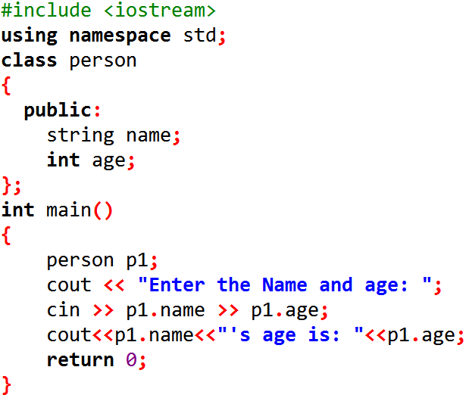
01
Class & Object
Notes:
An Object is an instance of a Class. When a class is defined, no memory is allocated but when it is instantiated (i.e. an object is created) memory is allocated.

Slide 9
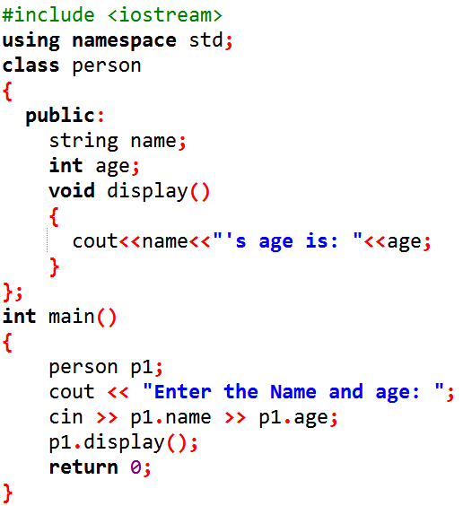
Class & Object
01
Notes:
An Object is an instance of a Class. When a class is defined, no memory is allocated but when it is instantiated (i.e. an object is created) memory is allocated.

Slide 10
OOP
class ClassName
{
// Access specifiers
// Data Members
// Member functions
};
Class
A class is a blueprint for the object.

Slide 11
OOP
An object is an instance of a class.
Class
Object
A class is a blueprint for the object.

Slide 12
OOP
Physical entity
Class
Object
Logical entity
Notes:
Logical entity - defines the object
Physical entity - Allocates memory (means physical action happening)

Slide 13
Class
Object
Container - collection of variables and functions
Container - collection of variables and functions
Container - collection of variables and functions
Object is a instance of class
No memory is allocated -during class declaration
No memory is allocated -during class declaration
No memory is allocated -during class declaration
Memory is allocated - during object declaration
One class definition - only once in the program.
One class definition - only once in the program.
For one class multiple objects can be created.

Slide 14
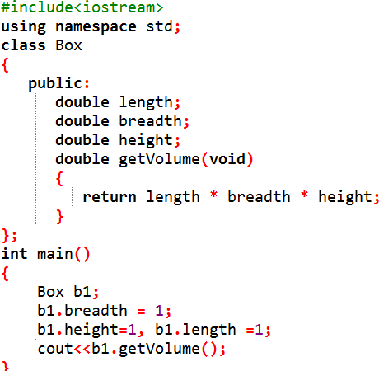
Member Functions in Classes:
Member function - defined inside the class.

Slide 15
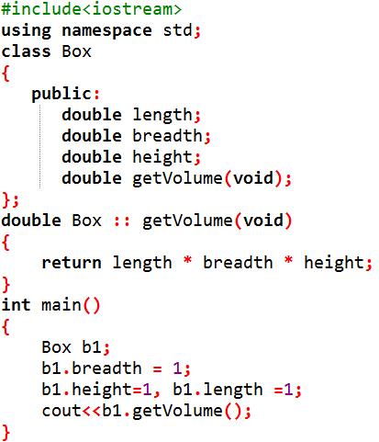
Member Functions in Classes:
Member function - declared inside the class.
Member function - defined outside the class.

Slide 16
Member Functions in Classes:
Syntax:
return type <class_name> :: <fn_name>
:: Scope resolution Operator

Slide 17
Constructors

Slide 18
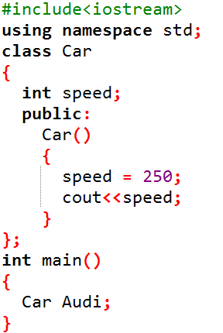
Constructors:
Constructor in C++ has the same name as class.
Contructors never have return type.
Invoked automatically at the time of object creation
Used to initialize the data members
Constructors can be defined either inside the class or outside the class
Notes:
Use of Constructor in C++
Suppose you are working on 100's of Person objects and the default value of a data member age is 0. Initialising all objects manually will be a very tedious task.
Instead, you can define a constructor that initialises age to 0. Then, all you have to do is create a Person object and the constructor will automatically initialise the age.
These situations arise frequently while handling array of objects.
Also, if you want to execute some code immediately after an object is created, you can place the code inside the body of the constructor.

Slide 19
Types of Constructors:
Default Constructor
Parameterized Constructor
Copy Constructor

Slide 20
Default Constructor
- It has no parameter.
Syntax :
class_name ()
{
Constructor Definition
}
Output:
250

Slide 21
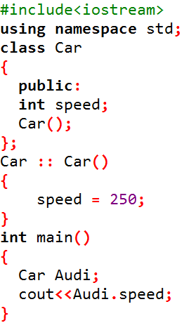
Default Constructor
Constructor definition - given outside the class using scope resolution operator ( :: )
Output:
250

Slide 22
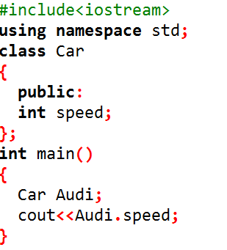
Default Constructor
If we do not define a constructor explicitly, the compiler will provide a default constructor implicitly.
Default constructor provided by the compiler - initialize the data members to default value (i.e., 0)
Output:
0
Notes:
A default constructor is so important for initialization of object members, that even if we do not define a constructor explicitly, the compiler will provide a default constructor implicitly.
In this case, default constructor provided by the compiler will be called which will initialize the object data members to default value, that will be 0 in this case.

Slide 23
Types of Constructors:
Default Constructor
Parameterized Constructor
Copy Constructor

Slide 24
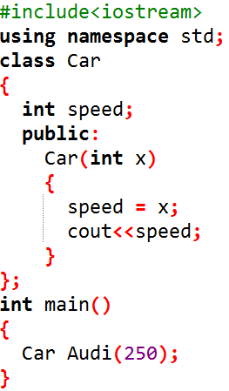
2. Parameterized Constructor
- Constructors with parameter
- Used to provide different values, by passing the values as argument during the object creation.
Output:
250

Slide 25
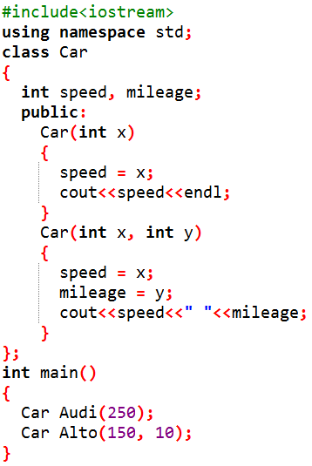
2. Parameterized Constructor
Constructor overloading:
Having more than one constructor in a class with same name, as long as each has a different list of arguments
Notes:
Overloaded constructors essentially have the same name (name of the class) and different number of arguments.
A constructor is called depending upon the number and type of arguments passed.
While creating the object, arguments must be passed to let compiler know, which constructor needs to be called.

Slide 26
2. Parameterized Constructor
Constructor overloading:
Overloaded constructors essentially have the same name (name of the class) and different number of arguments.
Notes:
Overloaded constructors essentially have the same name (name of the class) and different number of arguments.
A constructor is called depending upon the number and type of arguments passed.
While creating the object, arguments must be passed to let compiler know, which constructor needs to be called.

Slide 27
2. Parameterized Constructor
Constructor overloading:
A constructor is called depending upon the number and type of arguments passed.
While creating the object, arguments must be passed to let compiler know, which constructor needs to be called.
Output:
250
150 10
Notes:
Overloaded constructors essentially have the same name (name of the class) and different number of arguments.
A constructor is called depending upon the number and type of arguments passed.
While creating the object, arguments must be passed to let compiler know, which constructor needs to be called.

Slide 28
Types of Constructors:
Default Constructor
Parameterized Constructor
Copy Constructor

Slide 29
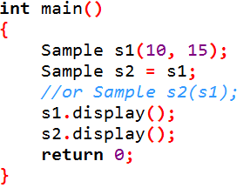
3. Copy Constructor
- It creates a new object, which is exact copy of the existing copy, hence it is called copy constructor.
Syntax of Copy Constructor:
Classname(const classname &objectname)
{
. . . .
}
Notes:
Overloaded constructors essentially have the same name (name of the class) and different number of arguments.
A constructor is called depending upon the number and type of arguments passed.
While creating the object, arguments must be passed to let compiler know, which constructor needs to be called.

Slide 30
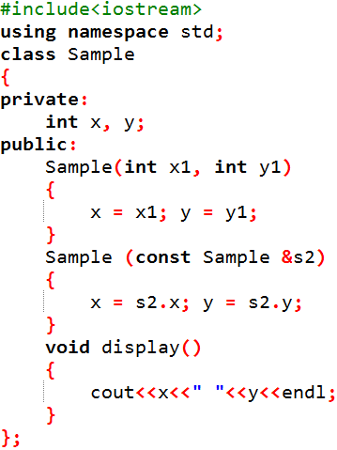
Output:
10 15
10 15

Slide 31
new operator

Slide 32

Memory Management
Code Segment:
Compiled program with executive instructions are kept in code segment.
It is read only.
In order to avoid over writing of stack and heap, code segment is kept below stack and heap.

Slide 33
Memory Management
Data Segment:
Global variables and static variables are kept in data segment.
It is not read only..

Slide 34
Memory Management
Stack:
A stack is usually pre-allocated memory.
The stack is a LIFO data structure.
Each new variable is pushed onto the stack.
Once variable goes out of scope, memory is freed. Once a stack variable is freed, that region of memory becomes available for other variables.
Notes:
The stack grows and shrinks as functions push and pop local variables. It stores local data, return addresses, arguments passed to functions and current status of memory.

Slide 35
Memory Management
Heap:
Memory is allocated during program execution.
i.e., Heap is used for Dynamic allocation.
Memory is allocated dynamically using new operator and deallocating memory using delete operator.
Notes:
The stack grows and shrinks as functions push and pop local variables. It stores local data, return addresses, arguments passed to functions and current status of memory.

Slide 36
Allocation of heap memory using new operator:
Syntax:
datatype pointername = new datatype
Example:
int *p = new int;
int *p = new int[10]; //Allocating block of memory
Notes:
The malloc() function from C, still exists in C++, but it is recommended to avoid using malloc() function. The main advantage of new over malloc() is that new doesn't just allocate memory, it constructs objects which is prime purpose of C++.

Slide 37
Deallocation of memory using delete operator:
Syntax:
delete pointer variable
Example:
delete p;
Notes:
At any point, when you feel a variable that has been dynamically allocated is not anymore required, you can free up the memory that it occupies in the free store with the ‘delete’ operator

Slide 38
new and delete operators
#include <iostream>
using namespace std;
int main ()
{
double* p = NULL;
p = new double;
*p = 29494.99;
cout << "Value of pvalue : " << *p << endl;
delete p;
return 0;
}
Value of p : 29495

